Slide 1

Week 1 (Tue): Historical Scots
/joanːa koˈpaʧɪk/
Joanna Kopaczyk
joanna.kopaczyk@glasgow.ac.uk
Drop-in hours: Tue 4-5pm, Zoom link on Moodle
ENGLANG1003
English Language and Linguistics 1B: Language, Society and Change

Slide 2
Scots then and now: What’s the plan?
Week 1 Introduction + Myth 1: Scots has no history
Week 2 Myth 2: Scots is a dialect of English
Week 3 Myth 3: Scots is used by uneducated people
Week 4 Myth 4: Scots is only good for banter
Week 5 What happened to Older Scots?
Weeks 7-11 Modern Scots with Jennifer Smith
Notes:
overview and taster

Slide 3
During the lecture: Mentimeter poll
What issues and topics would you like me to address in this lecture strand?
On your device, go to: www.menti.com
Enter event code: 27 62 89

Slide 4
Myth 1
Scots has no history

Slide 5
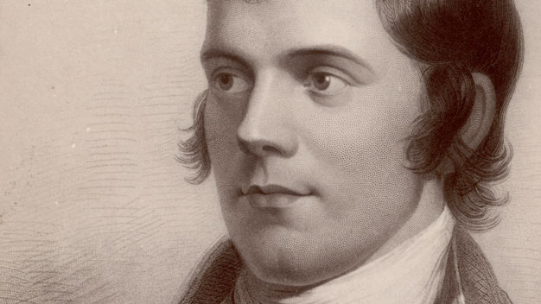
Robert Burns?
To a Mouse
Wee, sleekit, cow’rin, tim’rous beastie,
O, what a panic’s in thy breastie!
Thou need na start awa sae hasty,
Wi’ bickering brattle!
I wad be laith to rin an’ chase thee,
Wi’ murd’ring pattle!
…
That wee bit heap o’leave an’ stibble,
Has cost thee mony a weary nibble!
Now thou’s turn’d out, for a’ thy trouble,
But house or hald,
To thole the winter’s sleety dribble.
An’ cranreuch cauld!
1759-1796
image and text from: http://www.bbc.co.uk/arts/robertburns/
Notes:
In black: words shared with all English dialects (incl. standard English)
In green: words shared with northern English dialects
In blue: words/senses marked as Sc. in the OED (or supported only by quotations from Scottish authors)
Notice how the English spelling convention <ou> (in red) conceals Scots pronunciations (and bear in mind that it is often the case in post-1700 Scottish texts!)

Slide 6
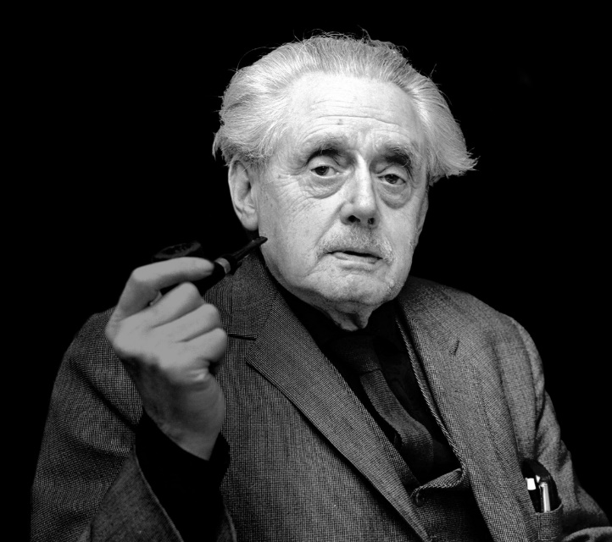
“Not Burns: Dunbar!”
“In MacDiarmid’s beautiful poem, Homage to Dunbar, he notes that anyone can visit the graves of Burns or Walter Scott, but nobody knows where Dunbar is buried, lost in an older Scotland, abandoned, unexplored. Like Atlantis drowned beneath the ocean, Dunbar and his Scotland remain almost unknown.”
(Alan Riach, The National, 22 January 2016 http://eprints.gla.ac.uk/149713/1/149713.pdf)
Hugh MacDiarmid
(Christopher Murray Grieve)
1892-1978
the main figure of the Scottish Renaissance in the early 20th century

Slide 7
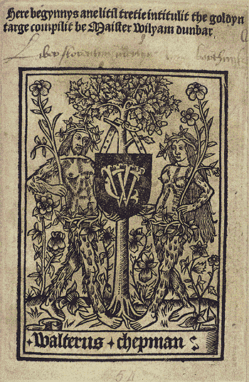
William Dunbar?
My heid did yak yester nicht,
This day to mak that I na micht.
So sair the magryme dois me menyie,
Perseing my brow as ony ganyie,
That scant I luik may on the licht.
Scottish makar
1459/60 – c.1530
a wide range of genres:
celebratory
political
religious and moral
satirical / courtly entertainment
personal
etc.

Slide 8
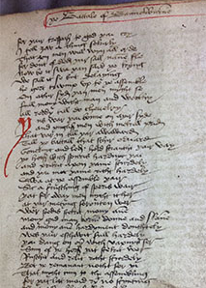
Literature in Scots (1375 – onwards)
The Brus (1375) by John Barbour
A 14,000-line poem about the Scottish Wars of Independence (1274-1329)
l. 225 A! Fredome is a noble thing
Fredome mays man to haiff liking.
Fredome all solace to man giffis,
He levys at es that frely levys.
A noble hart may haiff nane es
l. 230 Na ellys nocht that may him ples
Gyff fredome failyhe, for fre liking
Is yharnyt our all other thing.
edited by Prof. A.A. Duncan https://www.arts.gla.ac.uk/STELLA/STARN/poetry/BRUS/contents.htm

Slide 9
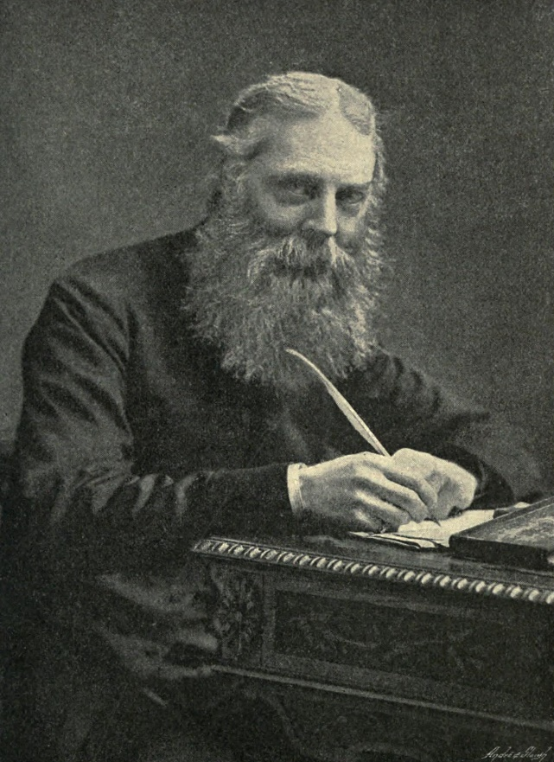
Earlier evidence?
“The history of the Northern dialect… from the year 1000 to nearly 1300, with few insignificant exceptions, is a total blank.”
Rev. W.W. Skeat, The English Dialects from the Eighth Century to the Present Day, 1912
Until quite recently, the linguistic history of the British Isles was focussed primarily on the history of Standard English.

Slide 10
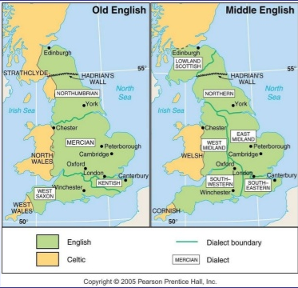
Dialect areas of Old vs Middle English
450-1100
1100-1450
SCOTS
700
1100
Chaucer

Slide 11
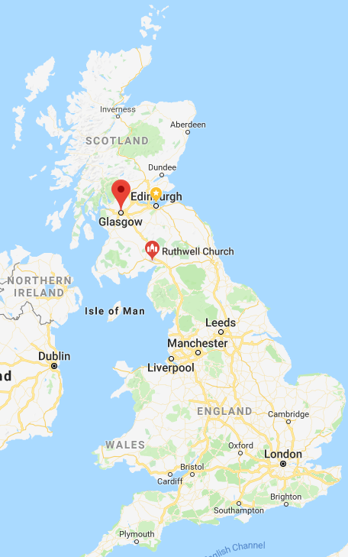
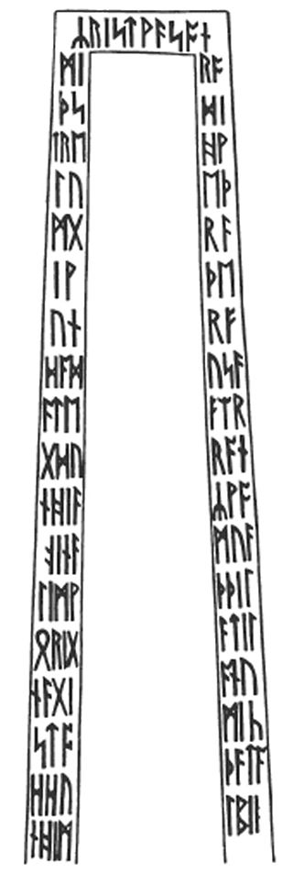
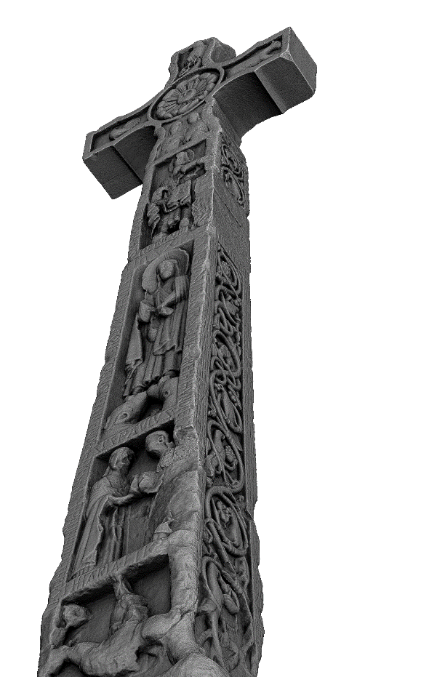
Evidence for the earliest Germanic language of the North: Old Northumbrian
The Ruthwell Cross in Dumfriesshire (early 8th c.)
By G. F. Browne - Alcuin of Yorkhttp://books.google.com/books?id=ho8QGIF5py8C, Public Domain
“It is both the most famous and elaborate Anglo-Saxon monumental sculpture, and possibly the oldest surviving "text" of Scots poetry, predating any manuscripts containing Old English poetry.” (Wikipedia: Ruthwell Cross) ☺

Slide 12
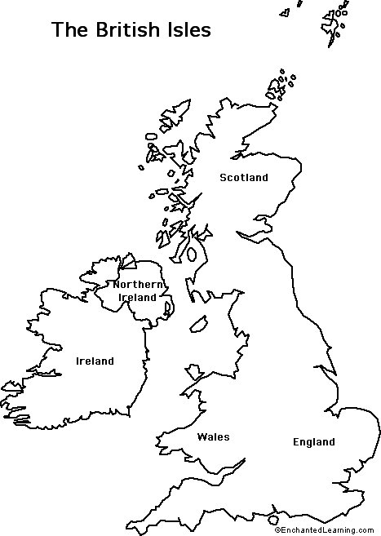
Multilingual Scotland
Who came when to Scotland?
Arrange in a chronological order:
Normans
Vikings
Romans
Anglo-Saxons
Celts
northern English migrants
https://youtu.be/pBb_jKKCcC8

Slide 13
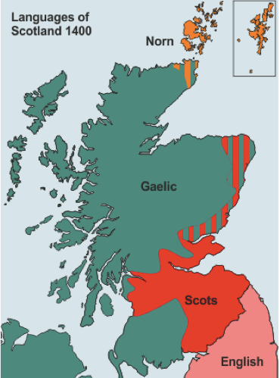
Above the Solway Firth – Tyne line
Gaelic = the language of the Scoti (the Celtic-speaking Scottish kingdom)
northern Germanic dialects (Anglian / Old Northumbrian) across the two kingdoms

Slide 14


Lexicographic resources
Scots enjoys a long lexicographic tradition:
Dictionary of the Older Scottish Tongue, up to 1700 = DOST (1931-2002)
+
Scottish National Dictionary, 1700-1945 = SND (1931-1976)
John Jamieson (1808) Etymological Dictionary of the Scottish Language > the first historical dictionary of Scots
for cross-checks with reference to English historical words and senses:

Slide 15
The DSL and the OED
How to access the dictionaries?
How to interpret dictionary information?
How to use this information to understand language history?
ganye / ganʒe
bairn
fashion
janitor
Watch the videos on Moodle where I show how to use the DSL and the OED using these examples!

Slide 16
How to use the DSL and the OED?
ANSWERS
ganye / ganʒe – a Scots word from Gaelic
bairn – a northern dialectal word as well as Scots
fashion – a general English word as well as Scots
janitor – a general English word today BUT used earlier in Scots (borrowed directly from Latin)

Slide 17
To recap
Scots has a long history, comparable in terms of depth to that of English.
We can study the history of Scots through literature and documents available since 1375.
For the period traditionally called ‘Old English’, the Germanic language of Scotland is Old Northumbrian.
For the period between Old Northumbrian and 1375, we rely on linguistic reconstruction, snippets embedded in Latin texts, and place-names.
The history of migrations is different for Scotland and England and has produced different linguistic outcomes.
The DSL and the OED give us insight into the histories of shared and unique vocabulary of Scots and English.
Notes:
go back to slido questions which came up during the lecture

Slide 18
Selected references
Aitken, A.J. 2017 (1985) Introduction [with revisions], in M. Robinson ed. The Concise Scots Dictionary. Edinburgh: EUP. ix-xxii.
Corbett, J. et al. 2003. A Brief History of Scots, in J. Corbett et al. eds, Edinburgh Companion to Scots. Edinburgh: EUP. 1-16.
Kopaczyk, Joanna. 2013. Rethinking the traditional periodisation of the Scots Language. In Robert McColl Millar and Janet Cruickshank (eds.) After the Storm: Papers from the Forum for Research on the Languages of Scotland and Ulster. University of Aberdeen. [online]
Macafee, C. and A. J. Aitken, ‘A history of Scots to 1700’, in A Dictionary of the Older Scottish Tongue vol. XII (2002), xxix-clvii. http://dsl.ac.uk/about-scots/history-of-scots/origins/
Murison, D. 1979. The Historical Background, in A.J. Aitken & T. McArthur eds, Languages of Scotland. Edinburgh: Chambers. 2-13.
Smith, J.J. 2012. About Older Scots, in Older Scots: A Linguistic Reader. Edinburgh: Scottish Text Society. 1-17.

